Slide 1
SECTION 0
Welcome to CSE/STAT 416 :)
AA

Slide 2
Contents of Today
Expectations/Introductions
Course Info
Numpy & Pandas Overview
Numpy & Pandas Demo
Sklearn Demo

Slide 3
Expectations &
Introductions
Engage with content
Small group discussion
Prep for HW
Alternative explanations
Ask questions
Fun!

Slide 4

About You - Icebreakers
Name
Department and Year
Why CSE/STAT 416?
Fav place/ sightseeing spot in Seattle?

Slide 5
Course Info
Course Website
Gradescope for submitting HW (conceptual)
HW conceptual portions
Learning reflections
Check grades
EdSTEM
Complete HW Programming in EdSTEM
(EdSTEM has the complete Python/Jupyter environment – you don’t need to write code on your local machine!)
Canvas for Zoom links, Lecture Recordings

Slide 6
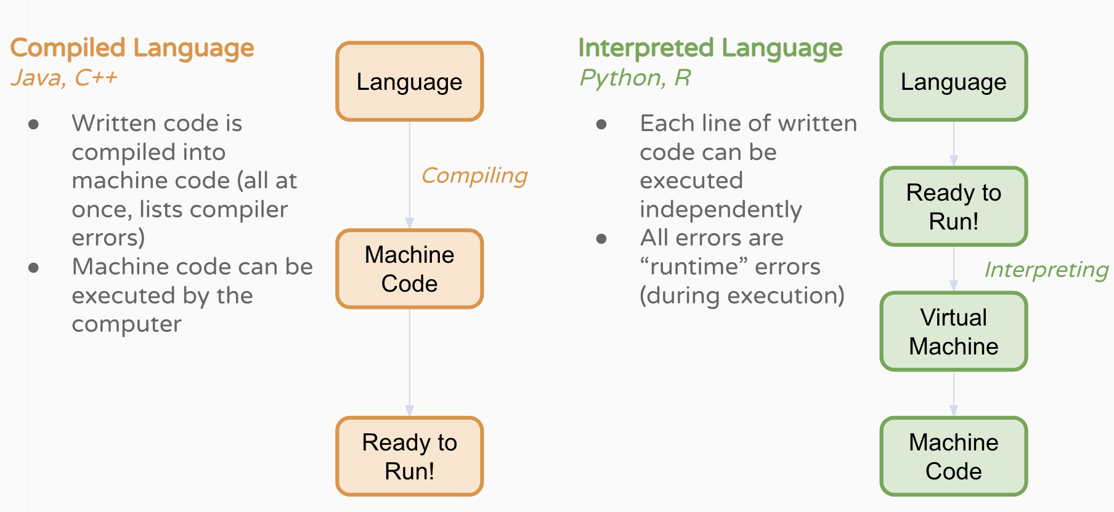
Python Introduction

Slide 7
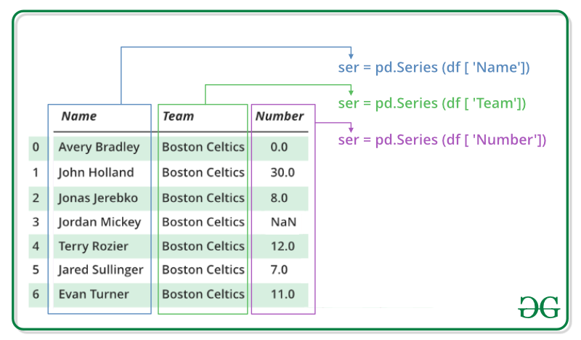
Numpy/Pandas Overview
Pandas:
Data Analysis
Numeric, alphabetical, heterogeneous types of data
DataFrames and Series
Numpy:
Mathematical functions
Numerical data
Arrays

Slide 8
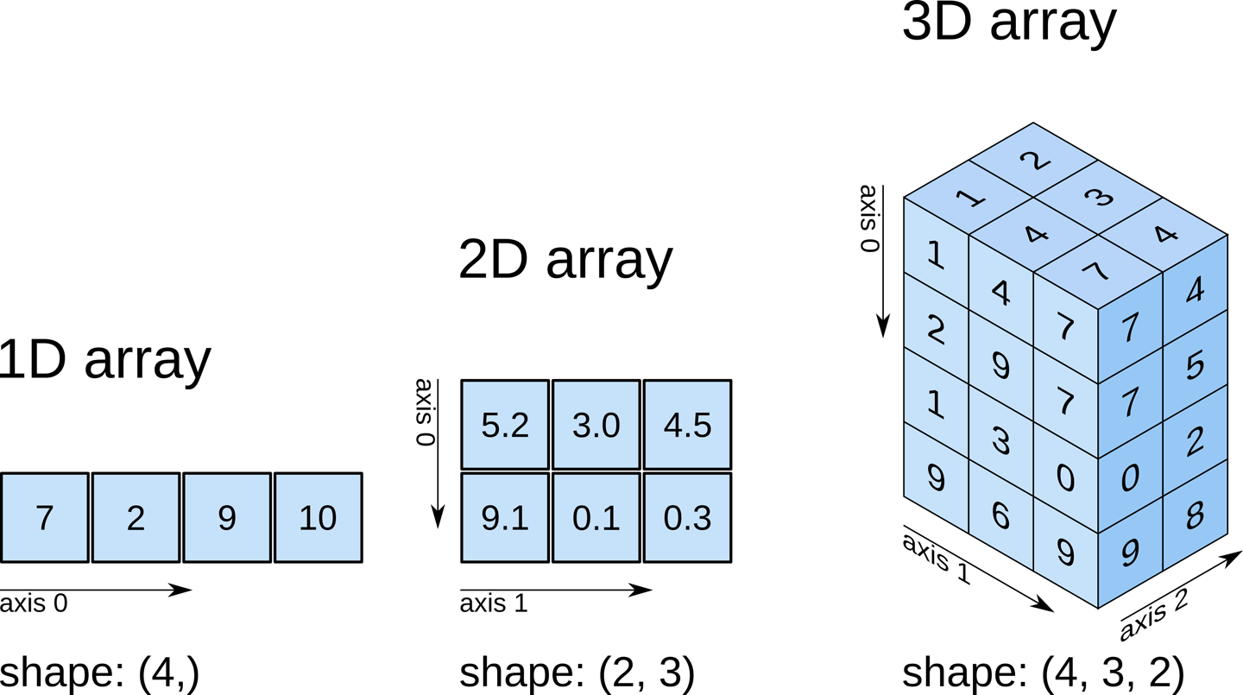
Numpy Arrays
Shape:
1D: Length
2D: rows, columns
3D: rows, columns, depth

Slide 9
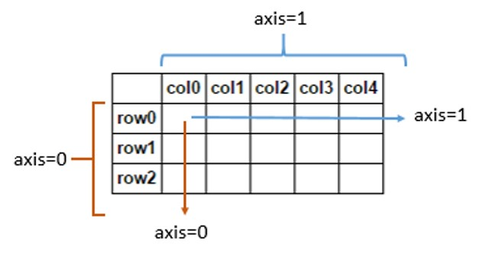
Numpy Arrays
Axis
Axis 0: rows (down the columns)
Axis 1: columns (across the rows)

Slide 10
Working with Pandas
Import package: import pandas as pd
Import CSV (aka dataset): dataset = pd.read_csv()
Look at the first couple data in the set: dataset.head()
Specific column: dataset[‘Column Name’]
(add .min() .max() .mean() to calculate whatever you want to calculate)
Index a specific cell in dataset: dataset[‘Column Name’].iloc[index]
Filter: dataset[boolean condition]
How many rows: len(dataset)
How many columns: len(dataset.columns)
Names of columns: dataset.columns

Slide 11
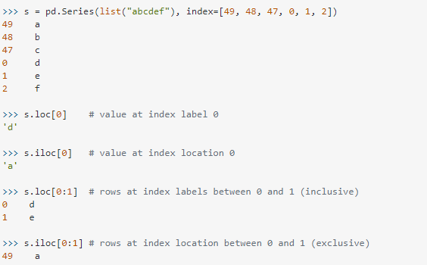
Working with Pandas
loc gets rows (and/or columns) with particular labels.
iloc gets rows (and/or columns) at integer locations.

Slide 12
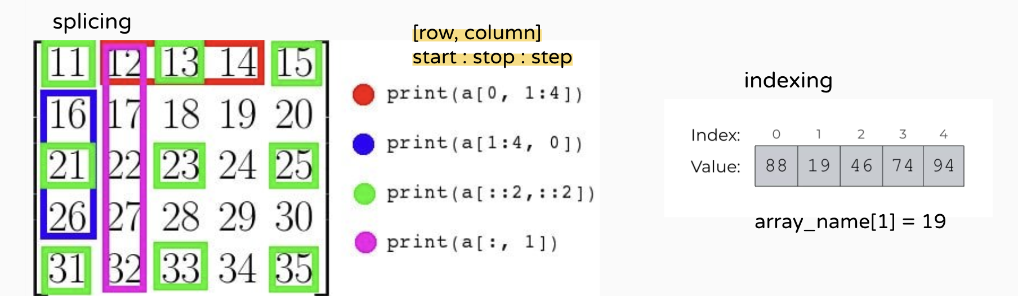
Working with Numpy
indexing accesses data at a particular location (e.g., a particular row and column) in an array
splicing selects multiple rows and columns

Slide 13
Working with Scikit Learn
Import model class: from sklearn.package_name import model_class
Creating an instance of the model class: model = model_class
Training the model: model.fit(data, target)
Viewing the learned weights: model.coef_
Performing prediction: model.predict(data)

Slide 14
Questions?

